Slide 1

Sync-Care
By: August DeWinkler, Genesi Gonzalez, Nicholas Gamarra, David Gibson and Nicholas Angiolilli

Slide 2
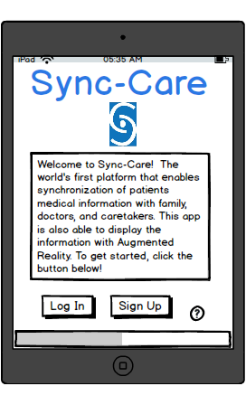
Home Page
Here is the home page for Sync Care, where we have a sign up for each user of the app. We want this app to be patient specific for our consumers, so each individual will get their own personalized page to their specific needs. And as you can see, at the bottom of our page we even support an advertisement bar. If you already have an account you are able to click the login button.

Slide 3
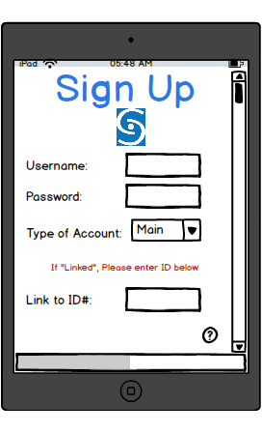
Sign Up
Here is the initial sign up page, where you can create an account as a viewer of patient information (family, caretaker, etc) while linking up to a specific patient. Or you can also create an account as a patient have store your information..

Slide 4
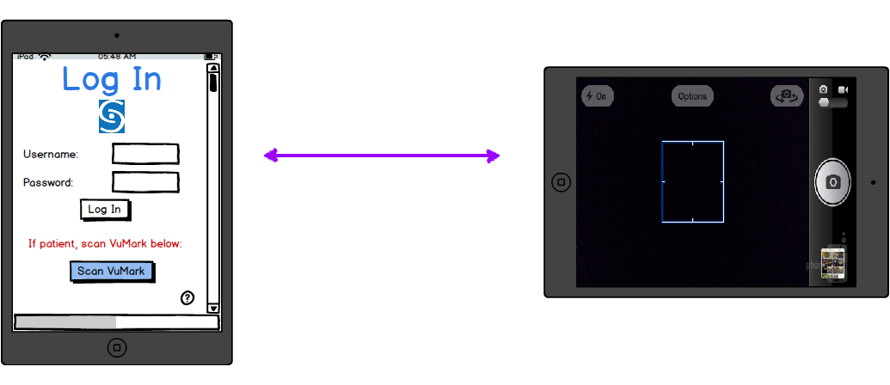
Log In
Here is the Log In page, if you are a family member or caretaker you will be using the log in with a self created username and password. However, in the image it shows a selected “Scan VuMark” which, as indicated, is by a patient using this app. As you can see the scanning from the camera will then open, allowing us to scan the generated, patient specific, VuMark.

Slide 5
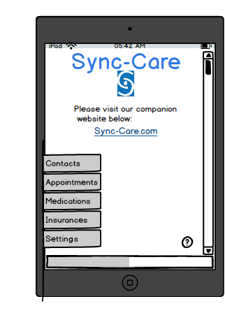
Main Page
Here is the main page of our app, where you can access different tabs that relate to the patient. If you are logged in as a family member or caretaker, it will show what account you are linked to. You can also access our website with the direct link.

Slide 6
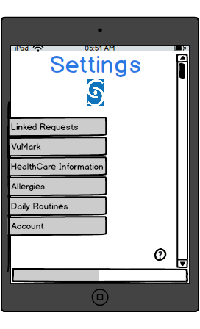
Logged in Settings Page
(Main Account)
Here is what the home page display would look like if you are logged in as a main account (or patient). You are able to access your linked requests, generate a VuMark for yourself, or view/edit pertinent information as well as manage your account.

Slide 7
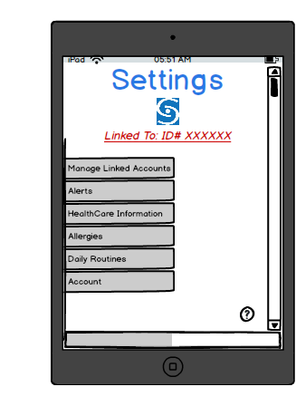
Logged in Settings Page
(Linked Account)
Here is what the home page display would look like if you are logged in as a linked account (family, caretaker, etc). You are able to access your linked accounts (you may have multiple), view/set your alerts, and view the relevant information for the selected linked account.

Slide 8
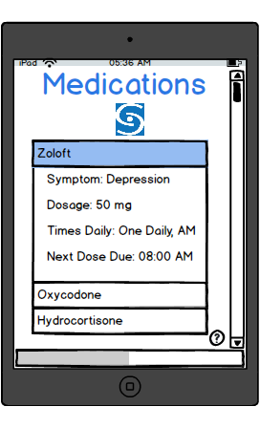
Medications
Here is an example of what the medications tab would look like. Here you can see a list of medications for the specific patient, and “Zoloft” is selected. Once selected, it shows all the information needed to monitor this specific medication.

Slide 9
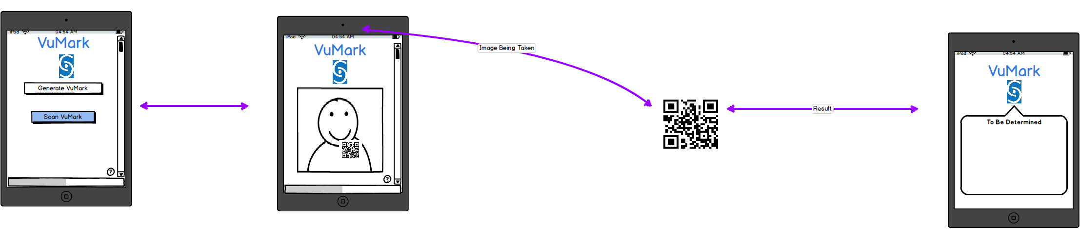
VuMark
Here you can see how our VuMark portion of our app will operate. You select “Scan VuMark” and the camera pops up once again, and you then scan the image. Once scanned, on your phone the Augmented Reality of the patients information pops up, displaying everything needed.

Slide 10
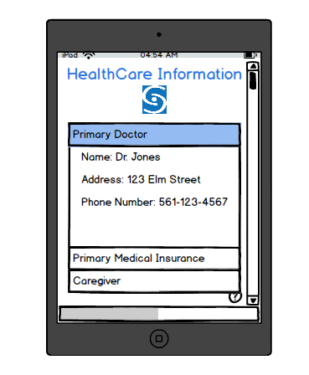
HealthCare Information
Here you are able to view all the healthcare information for the given patient. That includes: primary doctor, medical insurance, the caregiver or families information, and much more.

Slide 11
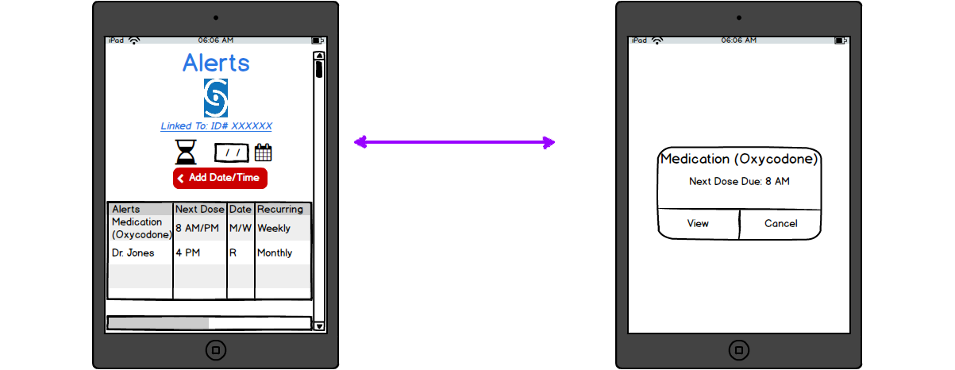
Alerts
The alerts, shown here in the “Linked” user, will be able to be set any time for anything. However the patient can also use alerts as well. Whether that is taking a certain medication, or remembering a doctors appointment, anything one deems applicable and necessary.

Slide 12
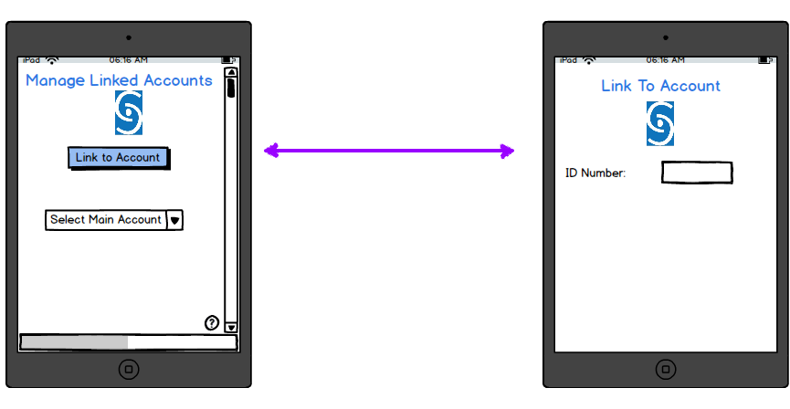
Managed Linked Accounts
In this tab you, a linked user, will be able to select which main account (patient) you want to view the information for. Or, as shown, you can click on “Link To Account” and enter the ID Number for a specific patient.

